Slide 1
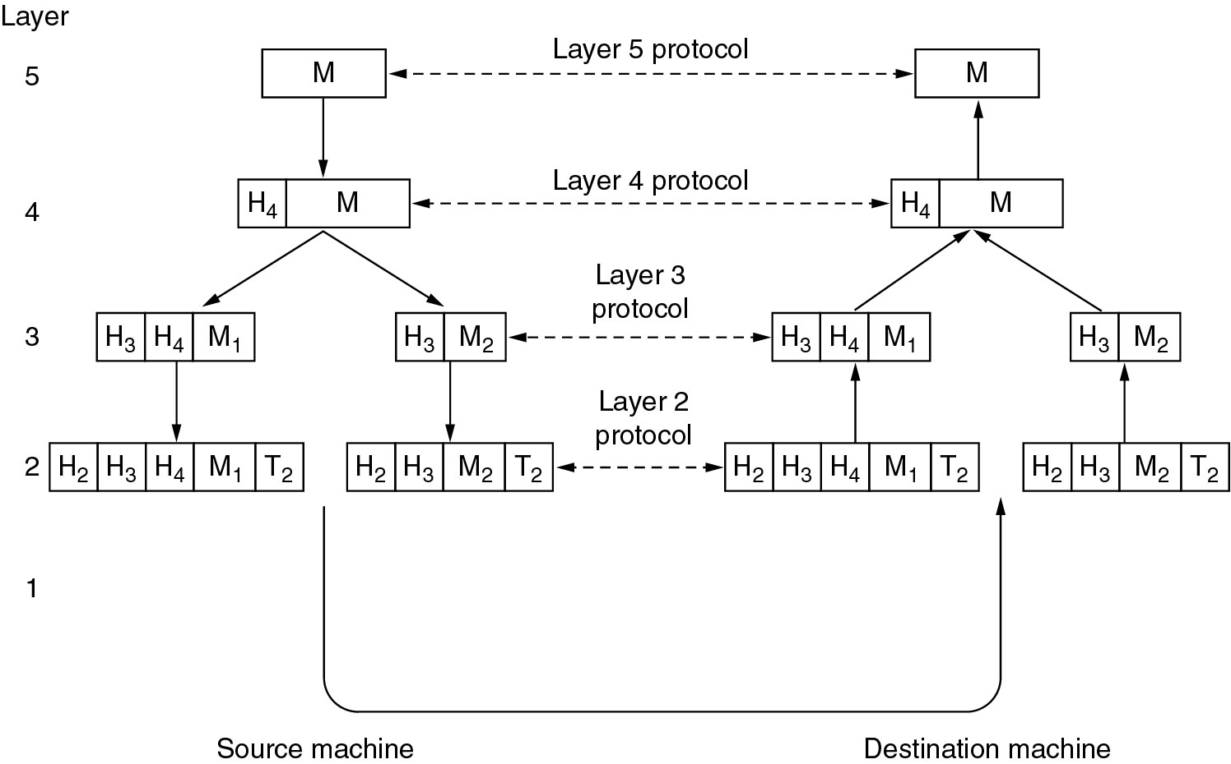
Protocol Hierarchies
Example information flow supporting virtual communication in layer 5.

Slide 2
Design Issues for the Layers
Addressing
Error Control
Flow Control
Multiplexing
Routing

Slide 3
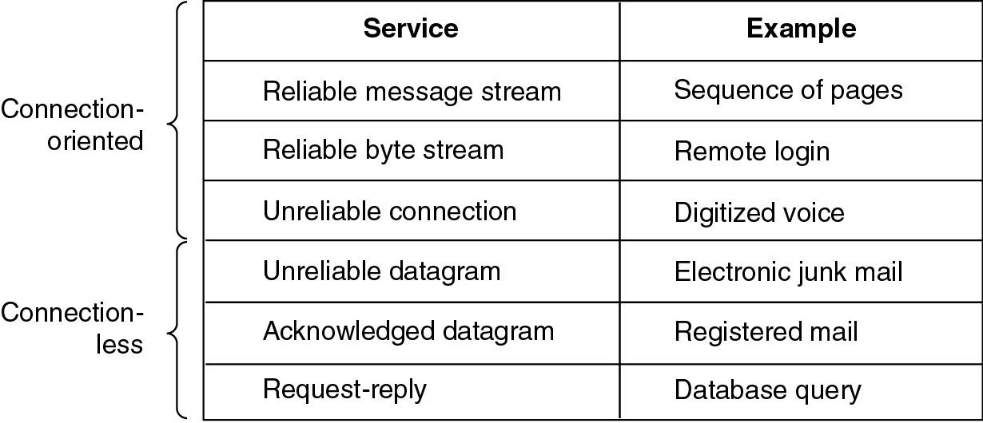
Connection-Oriented and Connectionless Services
Six different types of service.

Slide 4
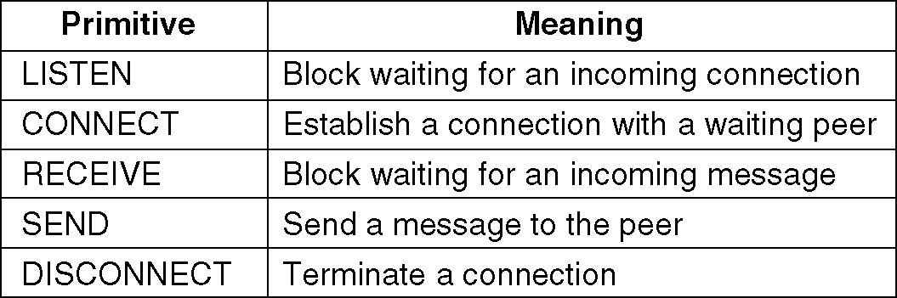
Service Primitives
Five service primitives for implementing a simple connection-oriented service.

Slide 5
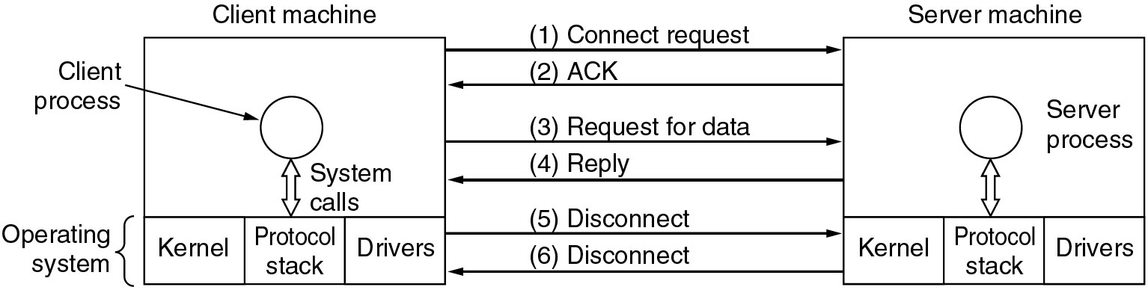
Service Primitives (2)
Packets sent in a simple client-server interaction on a connection-oriented network.

Slide 6
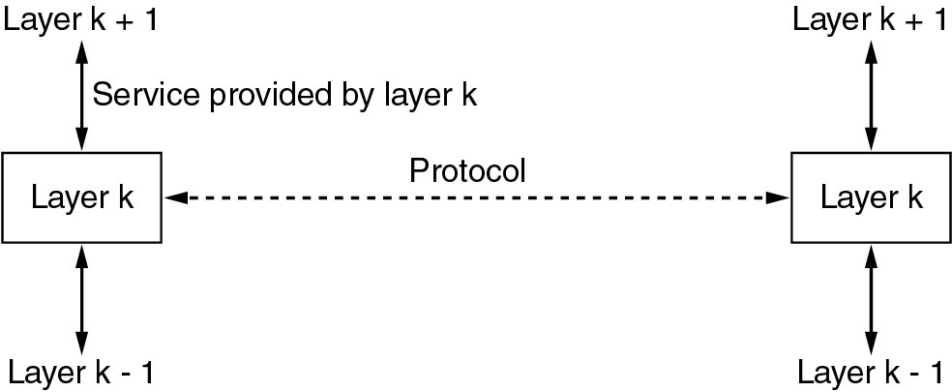
Services to Protocols Relationship
The relationship between a service and a protocol.

Slide 7
Reference Models
The OSI Reference Model
The TCP/IP Reference Model
A Comparison of OSI and TCP/IP
A Critique of the OSI Model and Protocols
A Critique of the TCP/IP Reference Model

Slide 8
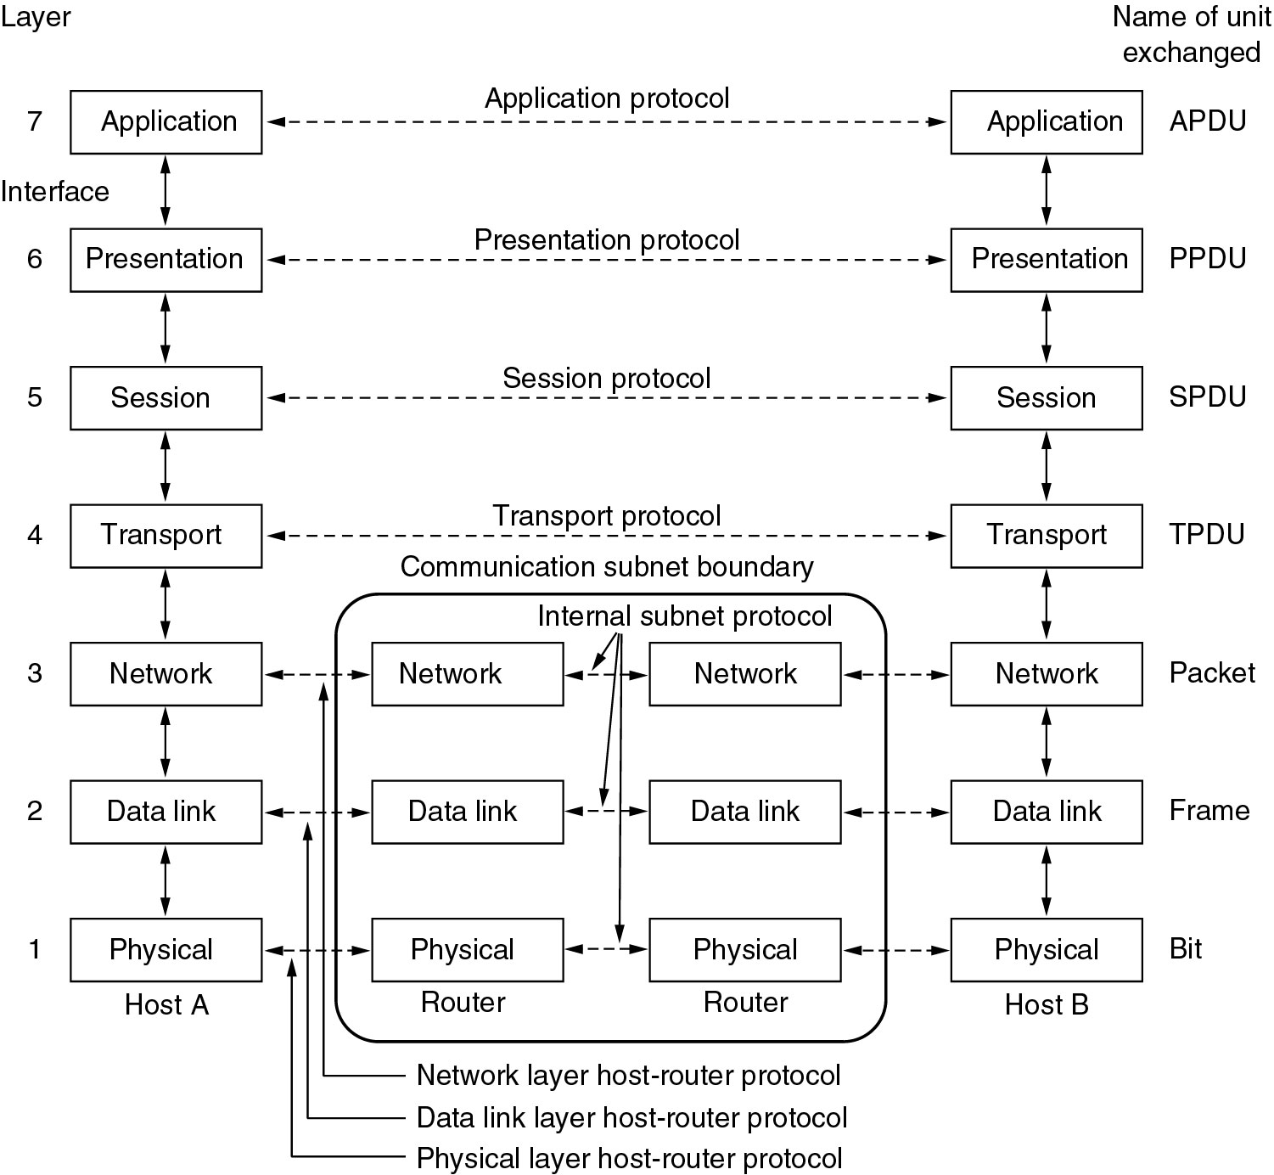
Reference Models
The OSI reference model.

Slide 9
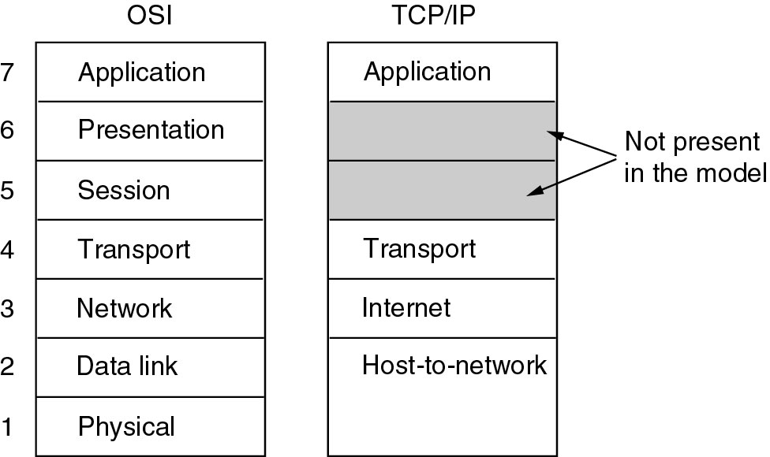
Reference Models (2)
The TCP/IP reference model.

Slide 10
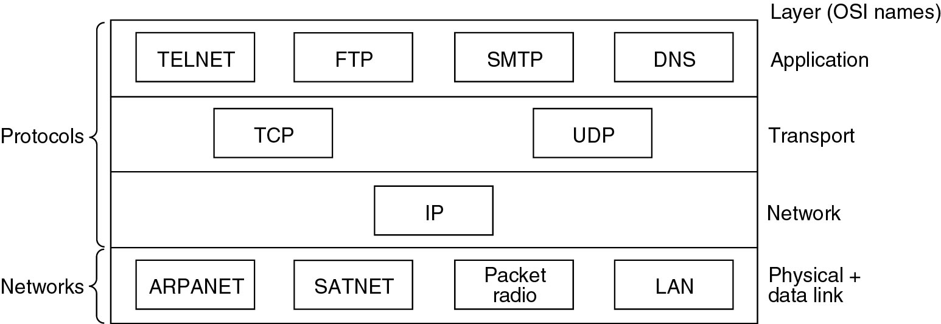
Reference Models (3)
Protocols and networks in the TCP/IP model initially.

Slide 11
Comparing OSI and TCP/IP Models
Concepts central to the OSI model
Services
Interfaces
Protocols

Slide 12
A Critique of the OSI Model and Protocols
Why OSI did not take over the world
Bad timing
Bad technology
Bad implementations
Bad politics

Slide 13
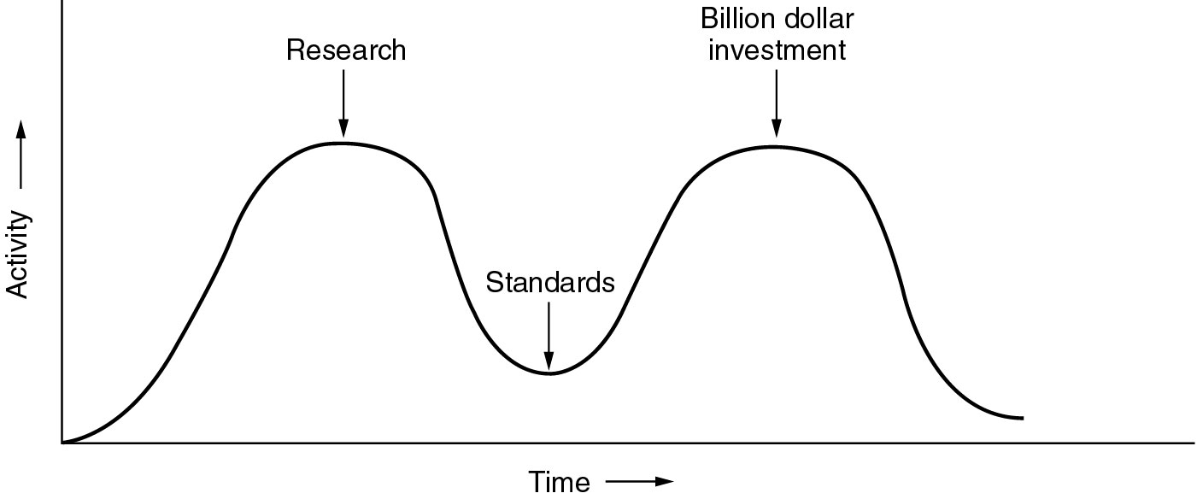
Bad Timing
The apocalypse of the two elephants.

Slide 14
A Critique of the TCP/IP Reference Model
Problems:
Service, interface, and protocol not distinguished
Not a general model
Host-to-network “layer” not really a layer
No mention of physical and data link layers
Minor protocols deeply entrenched, hard to replace

Slide 15
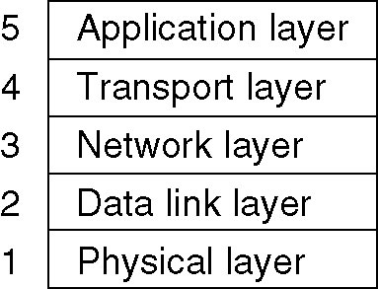
Hybrid Model
The hybrid reference model to be used in this book.

Slide 16
Example Networks
The Internet
Connection-Oriented Networks:
X.25, Frame Relay, and ATM
Ethernet
Wireless LANs: 802:11

Slide 17
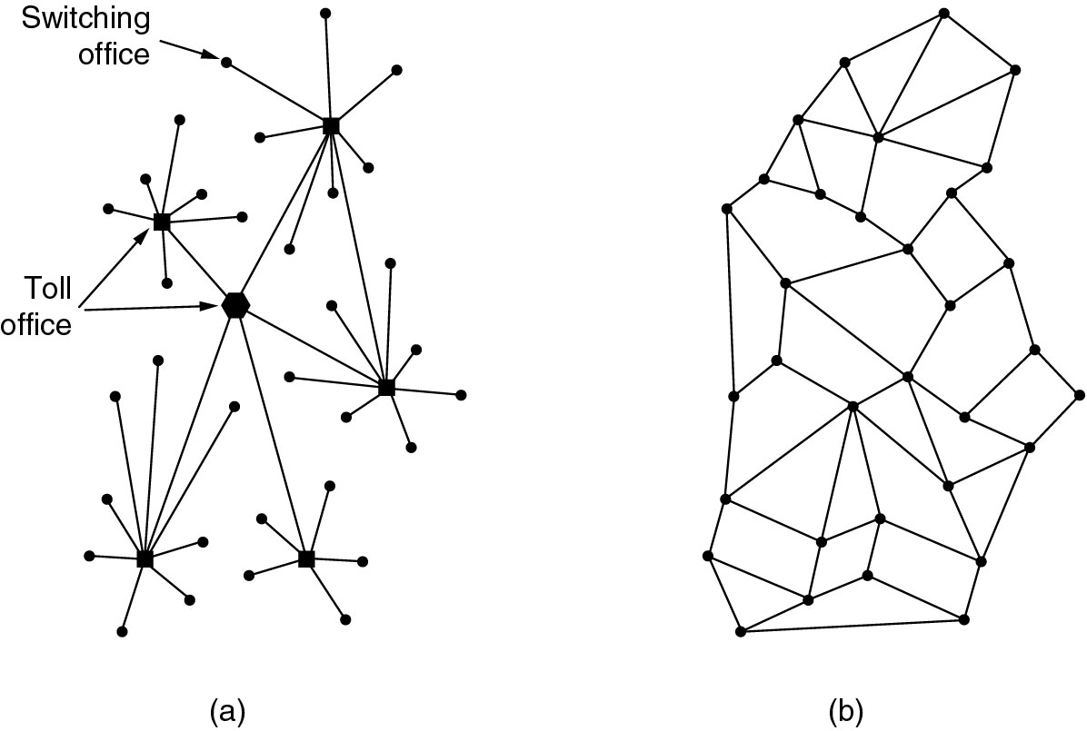
The ARPANET
(a) Structure of the telephone system.
(b) Baran’s proposed distributed switching system.

Slide 18
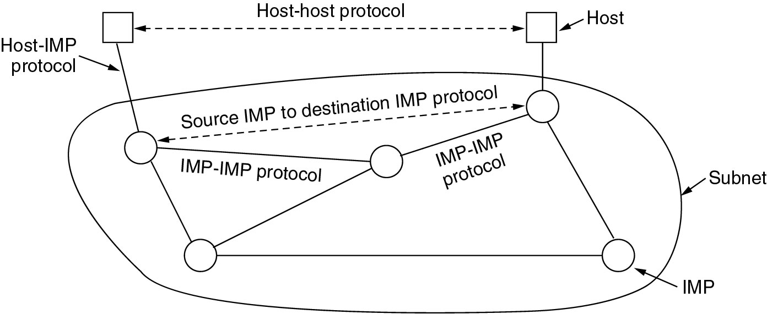
The ARPANET (2)
The original ARPANET design.

Slide 19
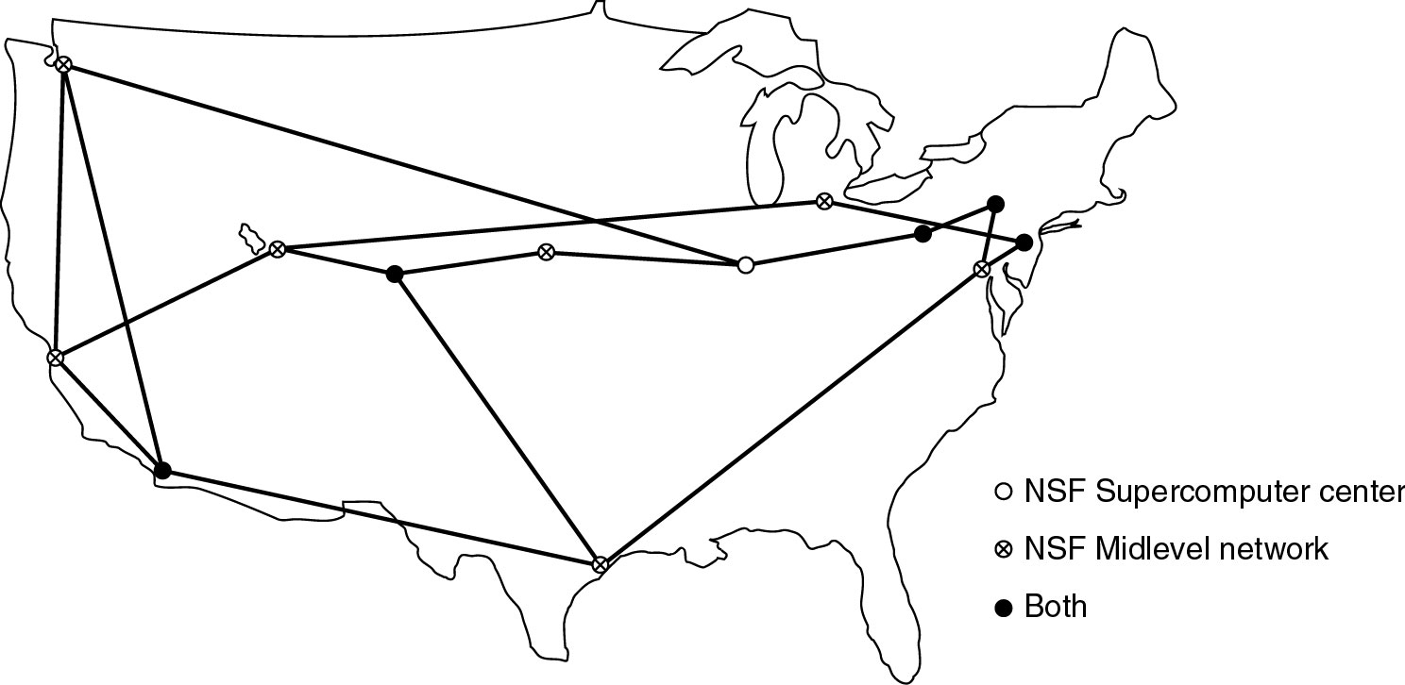
NSFNET
The NSFNET backbone in 1988.

Slide 20
Internet Usage
Traditional applications (1970 – 1990)
E-mail
News
Remote login
File transfer

Slide 21
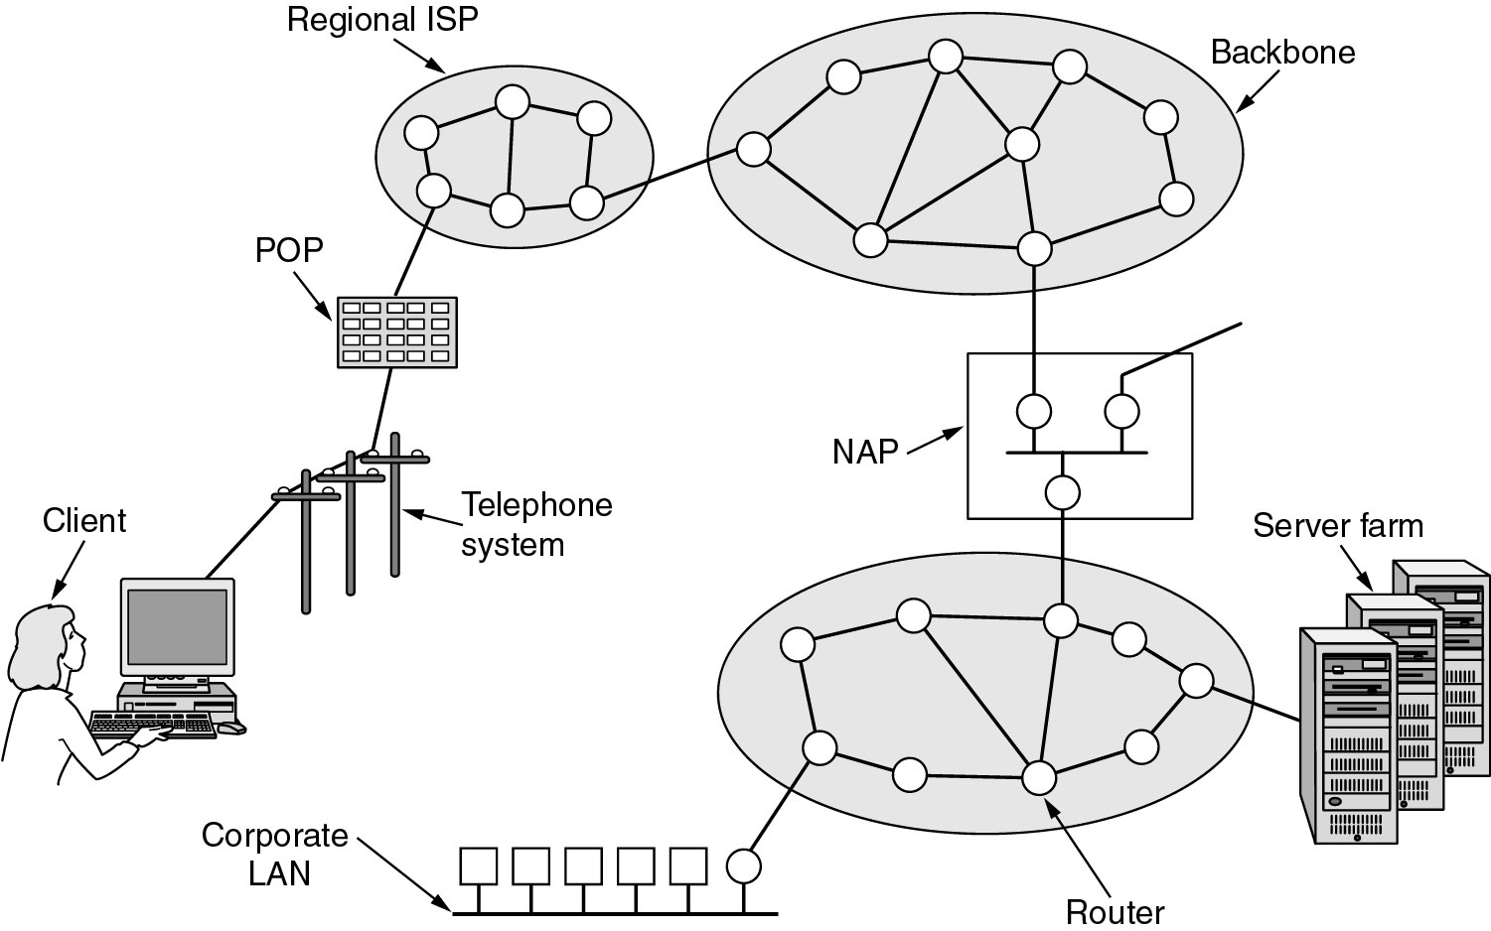
Architecture of the Internet
Overview of the Internet.

Slide 22
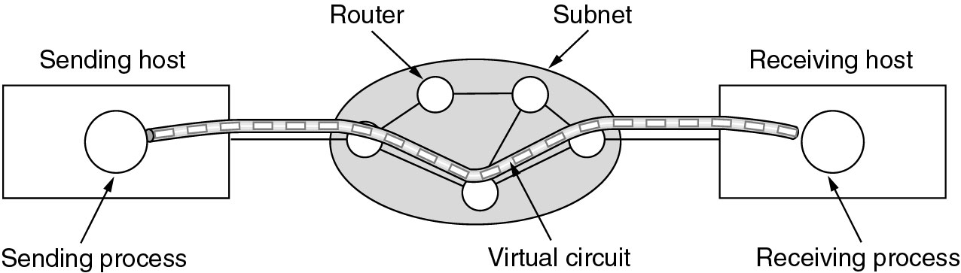
ATM Virtual Circuits
A virtual circuit.

Slide 23
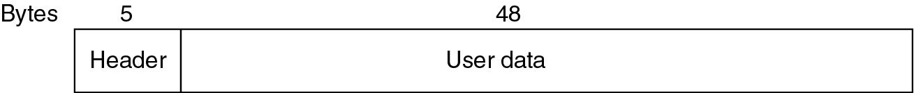
ATM Virtual Circuits (2)
An ATM cell.

Slide 24
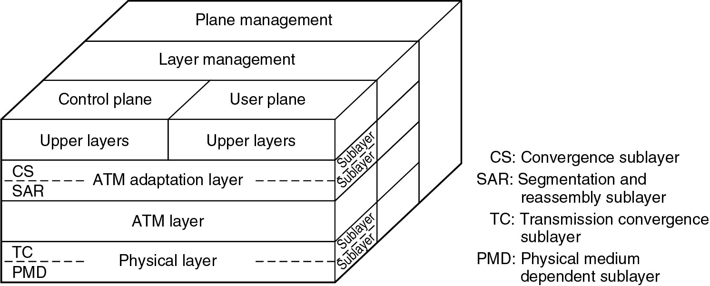
The ATM Reference Model
The ATM reference model.

Slide 25
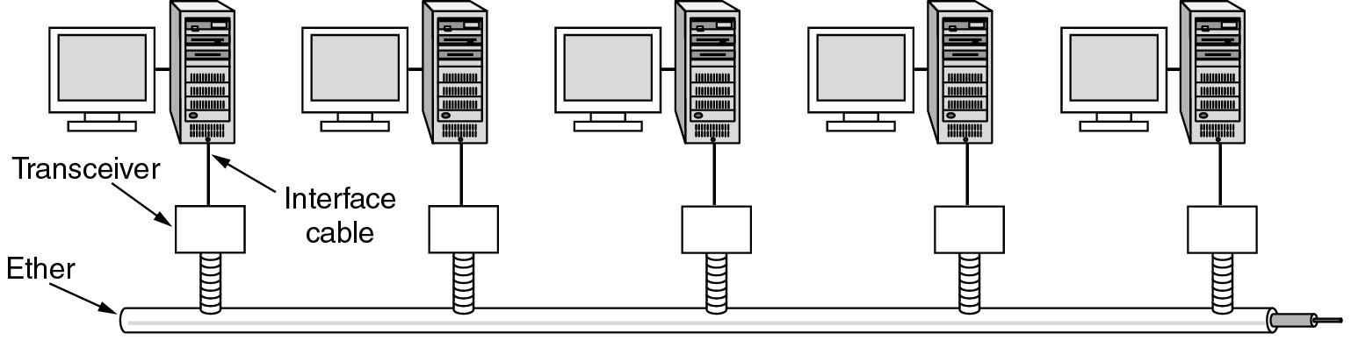
Ethernet
Architecture of the original Ethernet.

Slide 26
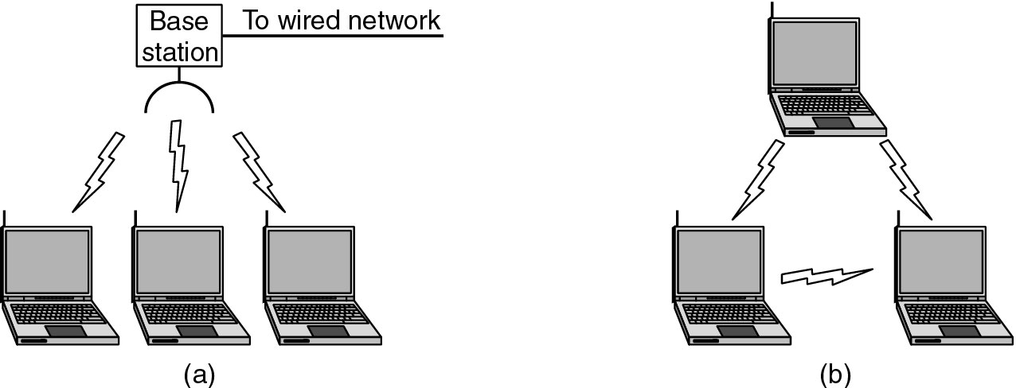
Wireless LANs
(a) Wireless networking with a base station.
(b) Ad hoc networking.

Slide 27
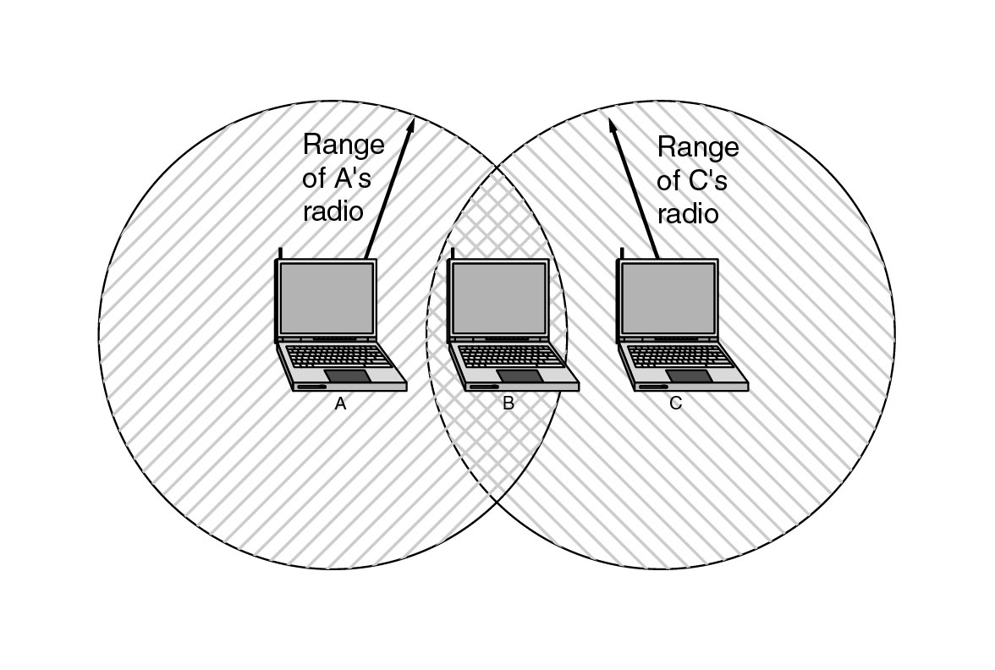
Wireless LANs (2)
The range of a single radio may not cover the entire system.

Slide 28
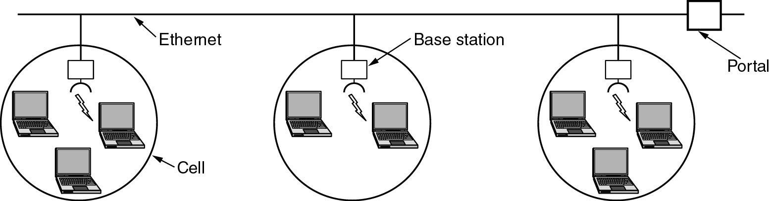
Wireless LANs (3)
A multicell 802.11 network.

Slide 29
Network Standardization
Who’s Who in the Telecommunications World
Who’s Who in the International Standards World
Who’s Who in the Internet Standards World

Slide 30
ITU
Main sectors
  Radiocommunications
  Telecommunications Standardization
  Development
Classes of Members
  National governments
  Sector members
  Associate members
  Regulatory agencies

Slide 31
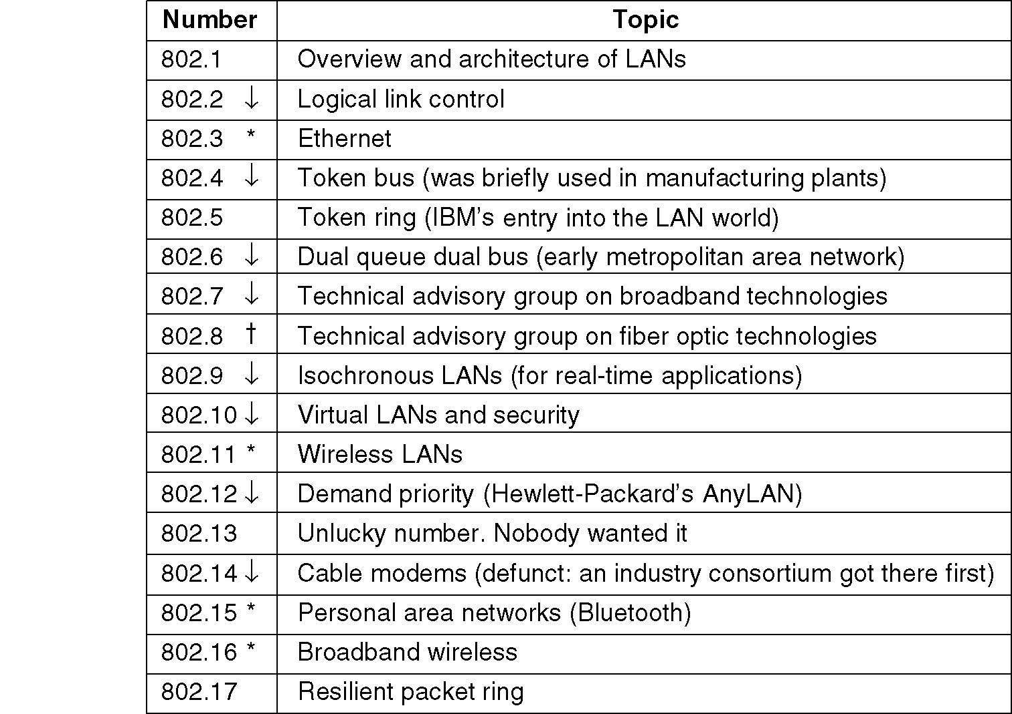
IEEE 802 Standards
The 802 working groups. The important ones are marked with *. The ones marked with ↓ are hibernating. The one marked with † gave up.

Slide 32
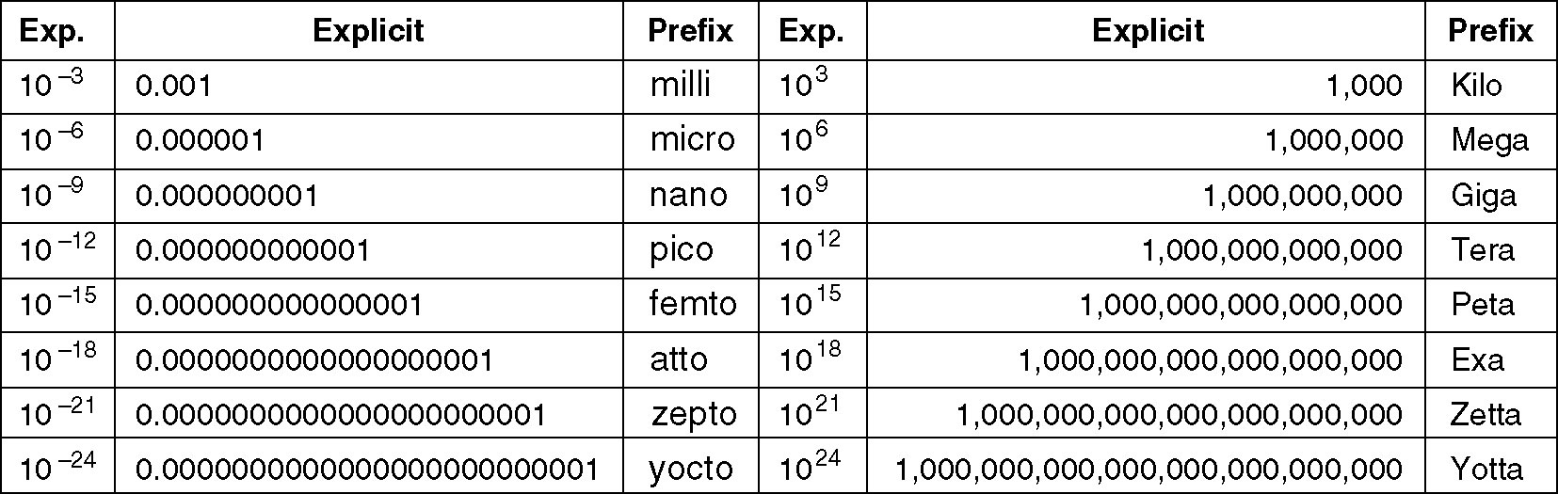
Metric Units
The principal metric prefixes.

Slide 33
OSI
Model
The model
Functions of the layers
WCB/McGraw-Hill
© The McGraw-Hill Companies, Inc., 1998

Slide 34
OSI
Model
The model is a product of the Open Systems Interconnection project at the International Organization for Standardization (ISO), maintained by the identification ISO/IEC 7498-1.
The Open Systems Interconnection model (OSI model) is a conceptual model that characterizes and standardizes the communication functions of a telecommunication or computing system without regard to their underlying internal structure and technology.
Its goal is the interoperability of diverse communication systems with standard protocols. The model partitions a communication system into abstraction layers.

Slide 35

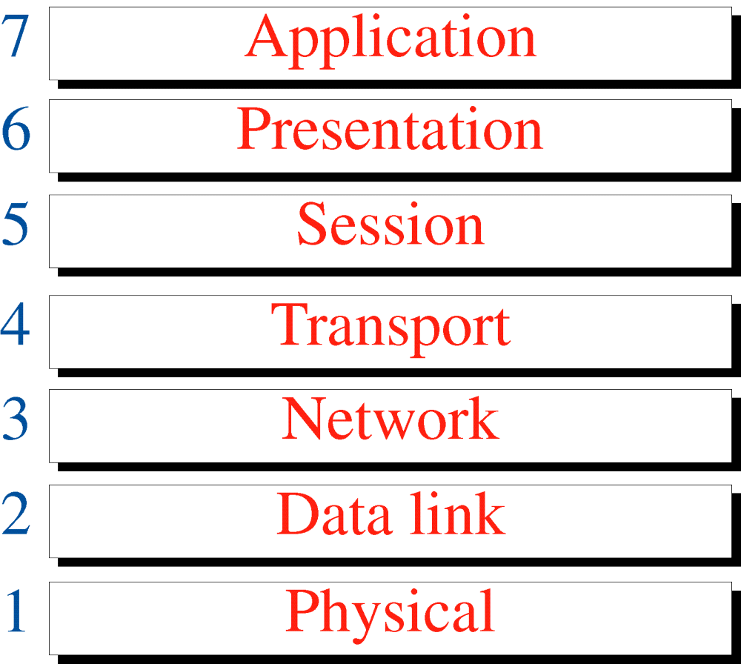
Figure 3-1
OSI Model
Please Do Not Throw Sausage Pizza Away!
All
People
Seem
To
Need
Data
Processing
WCB/McGraw-Hill
© The McGraw-Hill Companies, Inc., 1998

Slide 36
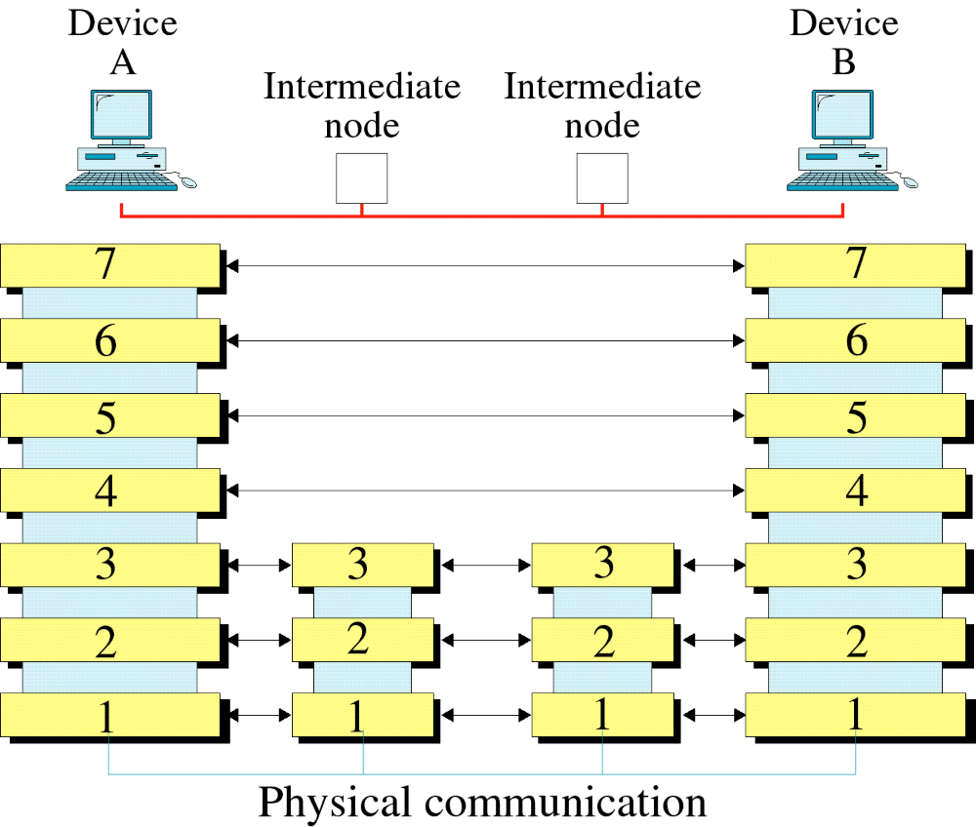
Figure 3-2
OSI Layers
WCB/McGraw-Hill
© The McGraw-Hill Companies, Inc., 1998

Slide 37
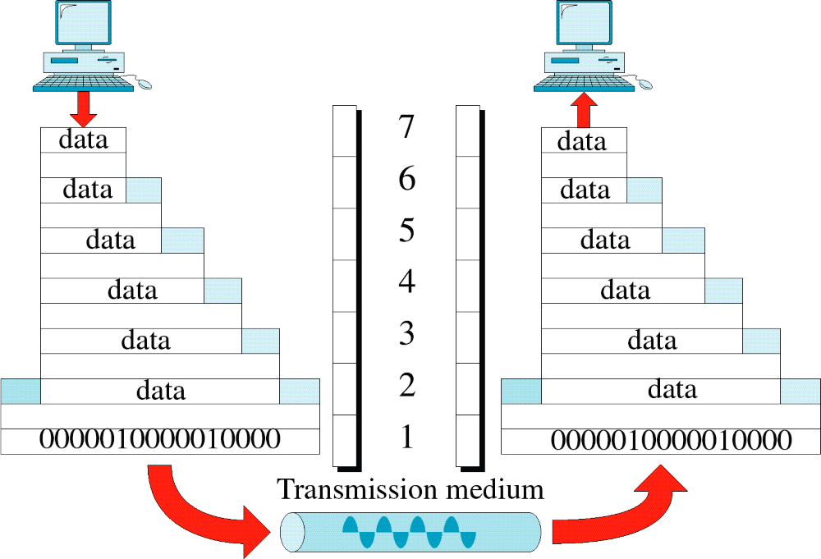
Figure 3-3
An Exchange Using the OSI Model
WCB/McGraw-Hill
© The McGraw-Hill Companies, Inc., 1998

Slide 38
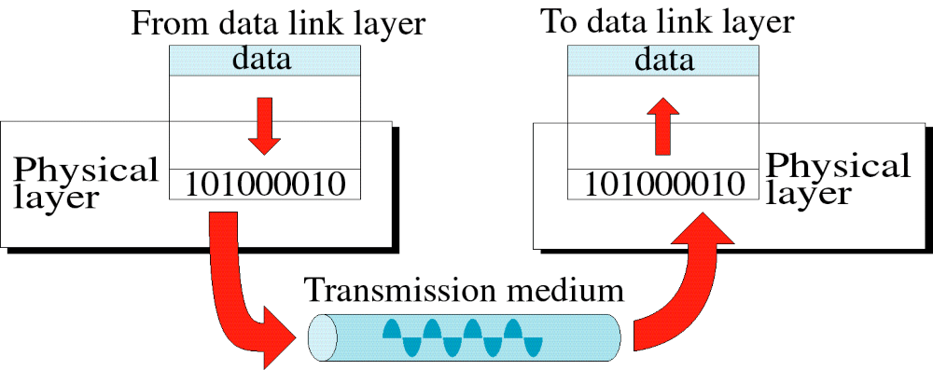
Figure 3-4
Physical Layer
WCB/McGraw-Hill
© The McGraw-Hill Companies, Inc., 1998

Slide 39
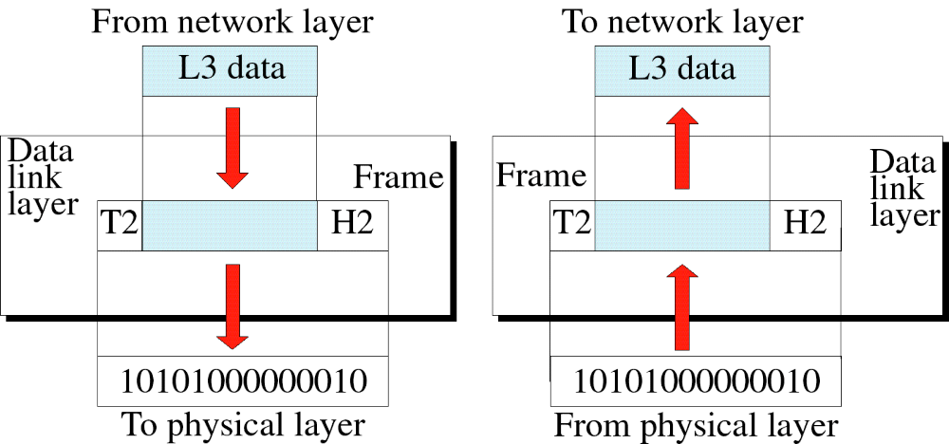
Figure 3-5
Data Link Layer
WCB/McGraw-Hill
© The McGraw-Hill Companies, Inc., 1998

Slide 40
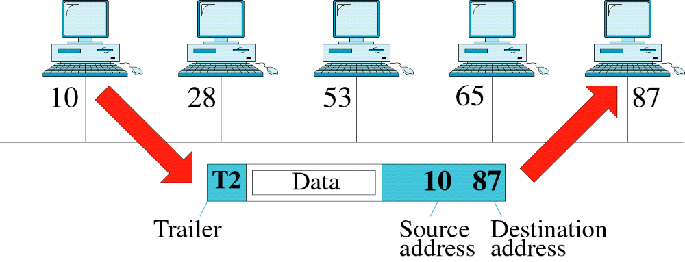
Figure 3-6
Data Link Layer Example
WCB/McGraw-Hill
© The McGraw-Hill Companies, Inc., 1998

Slide 41
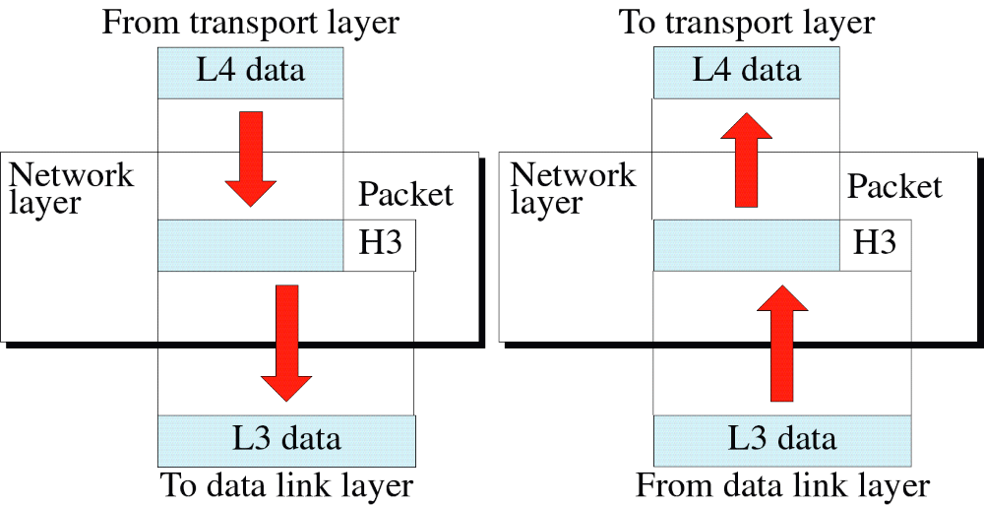
Figure 3-7
Network Layer
WCB/McGraw-Hill
© The McGraw-Hill Companies, Inc., 1998

Slide 42
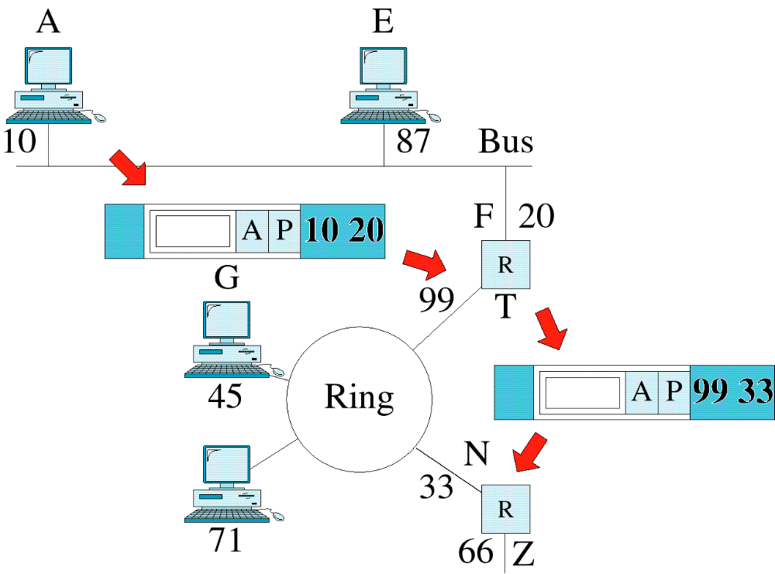
Figure 3-8
Network Layer Example
WCB/McGraw-Hill
© The McGraw-Hill Companies, Inc., 1998

Slide 43
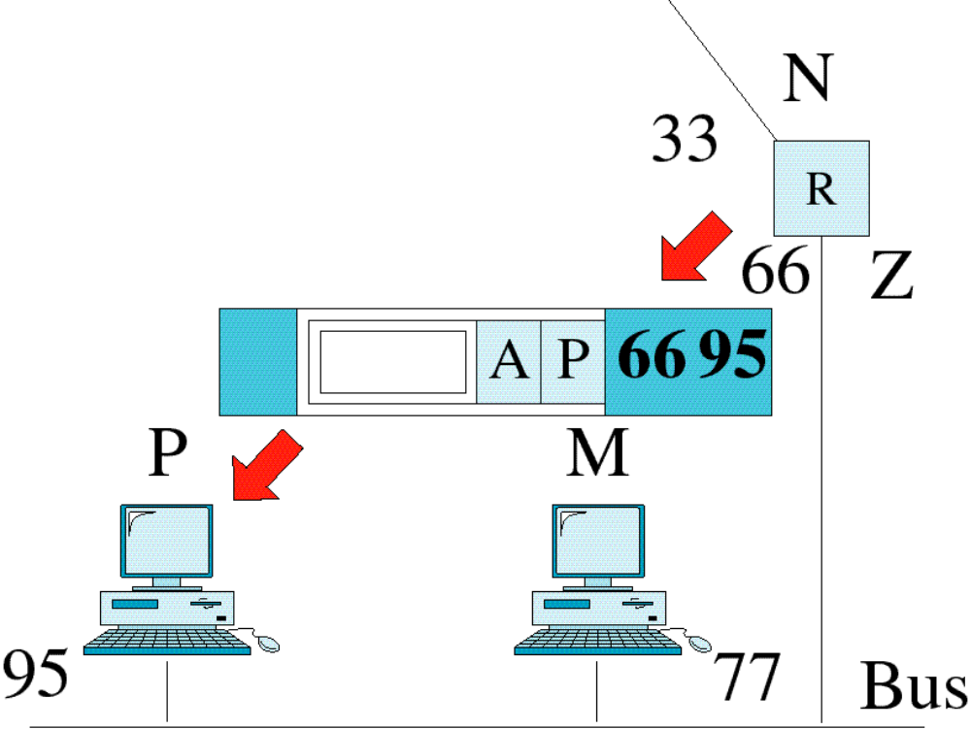
Figure 3-8-continued
Network Layer Example
WCB/McGraw-Hill
© The McGraw-Hill Companies, Inc., 1998

Slide 44
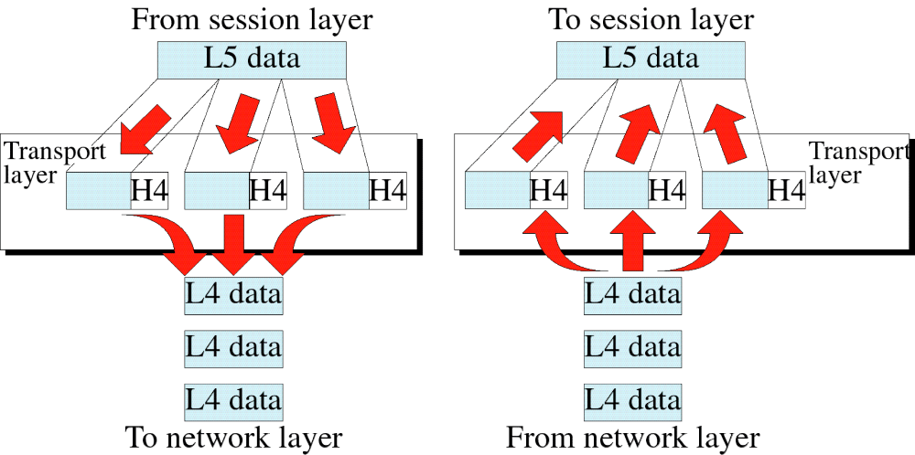
Figure 3-9
Transport Layer
WCB/McGraw-Hill
© The McGraw-Hill Companies, Inc., 1998

Slide 45
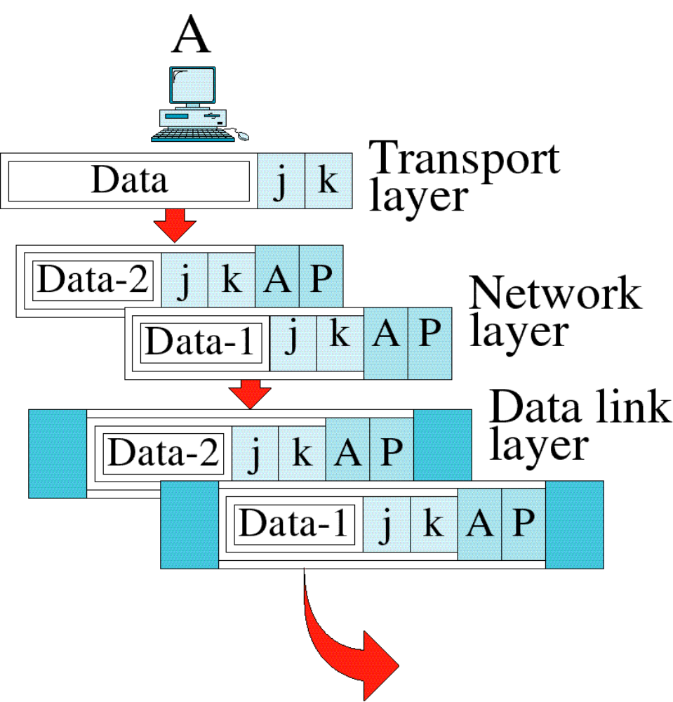
Figure 3-10
Transport Layer Example
WCB/McGraw-Hill
© The McGraw-Hill Companies, Inc., 1998

Slide 46
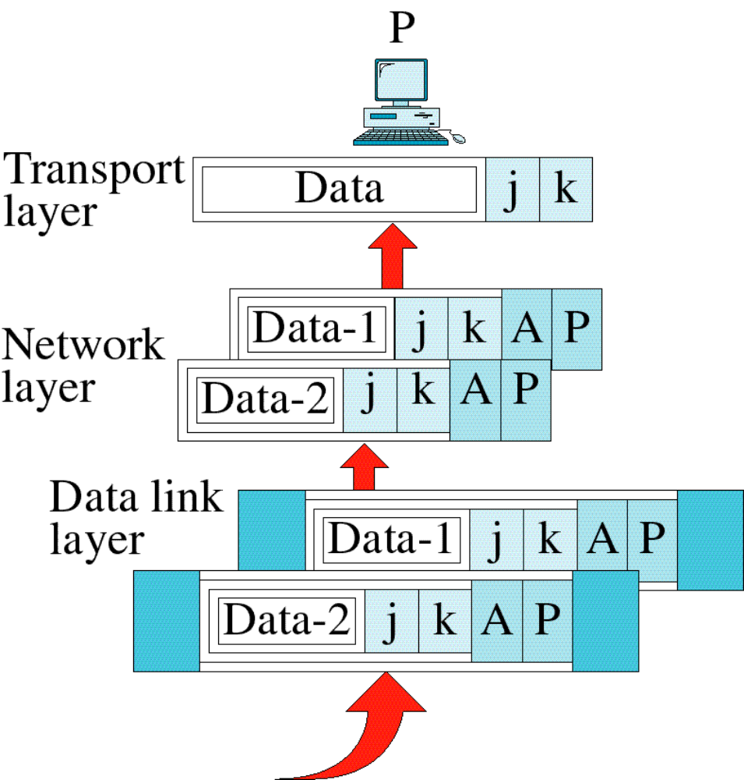
Figure 3-10-continued
Transport Layer Example
WCB/McGraw-Hill
© The McGraw-Hill Companies, Inc., 1998

Slide 47
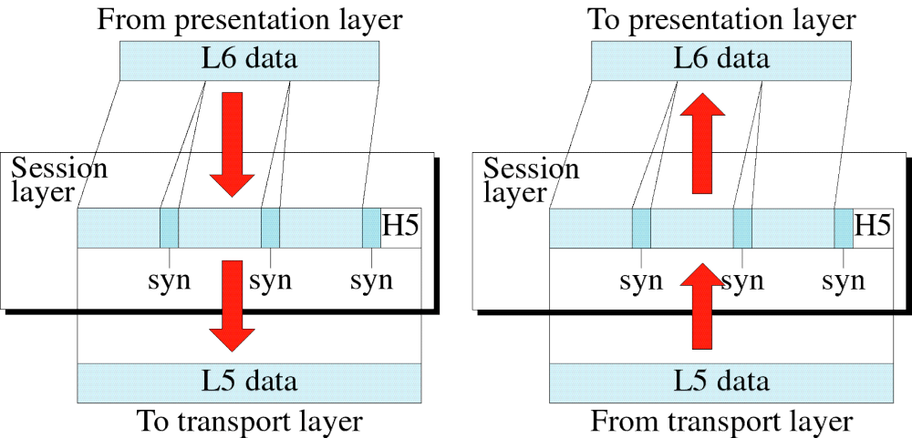
Figure 3-11
Session Layer
WCB/McGraw-Hill
© The McGraw-Hill Companies, Inc., 1998

Slide 48
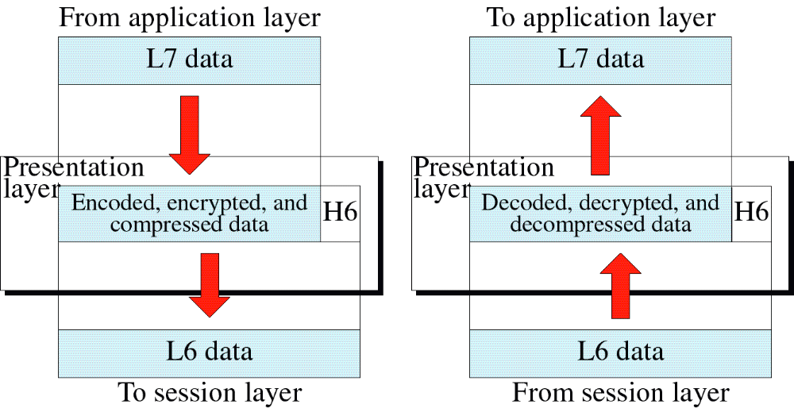
Figure 3-12
Presentation Layer
WCB/McGraw-Hill
© The McGraw-Hill Companies, Inc., 1998

Slide 49
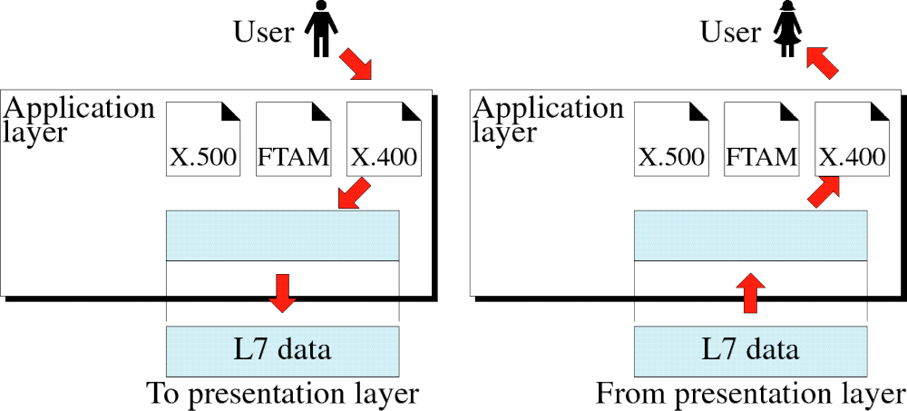
Figure 3-13
Application Layer
WCB/McGraw-Hill
© The McGraw-Hill Companies, Inc., 1998

Slide 50
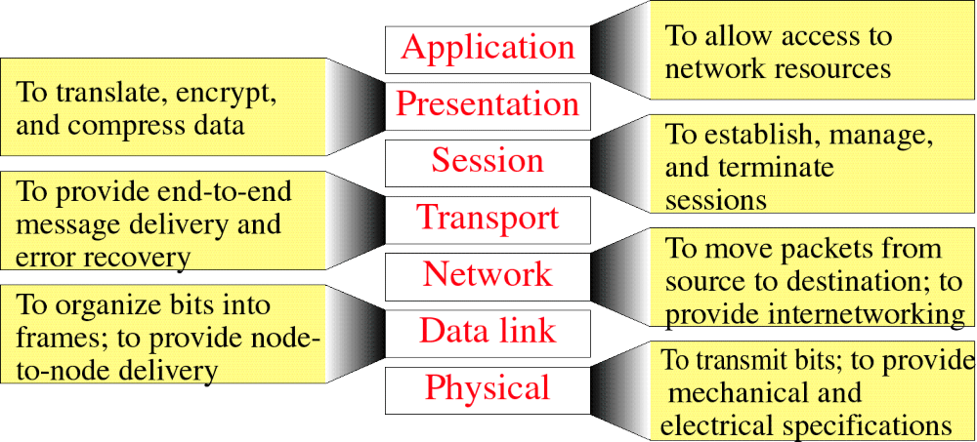
Figure 3-14
Summary of Layer Functions
WCB/McGraw-Hill
© The McGraw-Hill Companies, Inc., 1998

